Slide 1


Instructor Resources
Chapter 4 Figures
Instructor Resources
Chapter 4 Figures
Cover photo: BeautyStock – stock.adobe.com.

Slide 2
Chapter 4
Turbine Aircraft Power Systems

Slide 3
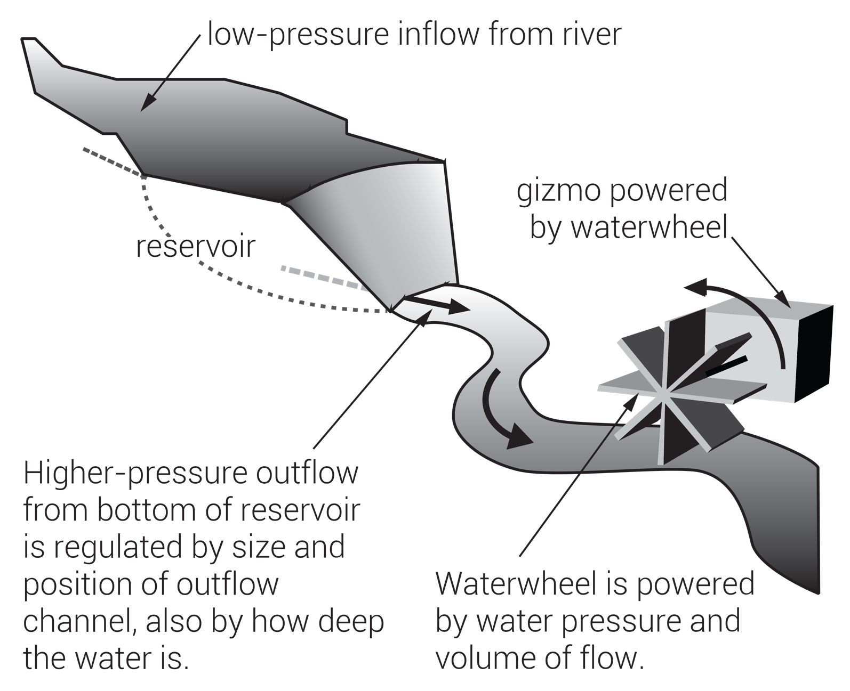
FIGURE 4.1
Simple waterwheel.

Slide 4
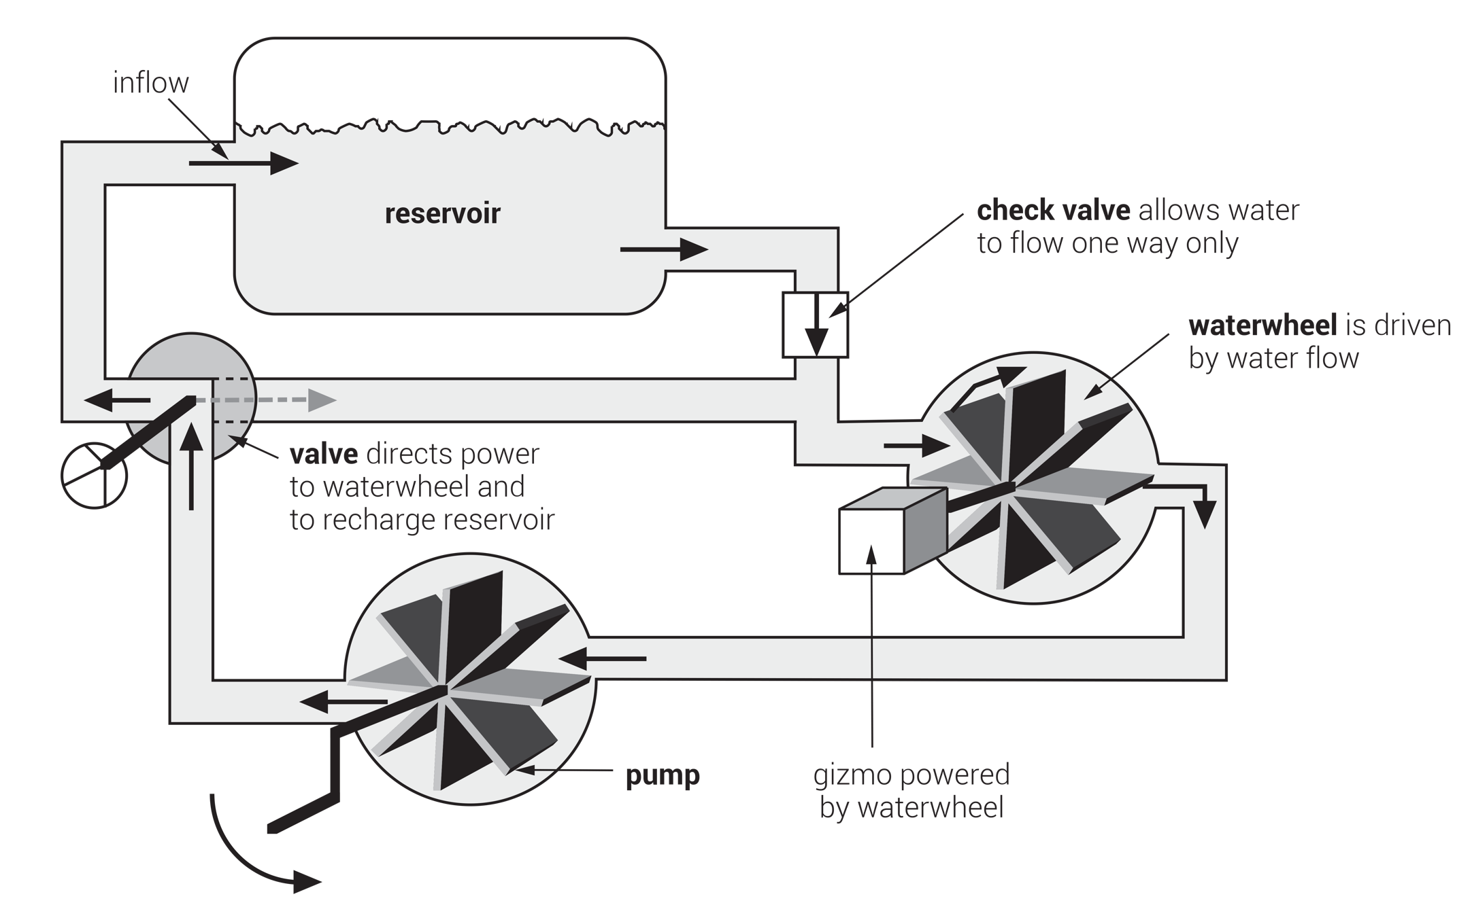
FIGURE 4.2
Reference waterwheel system.

Slide 5
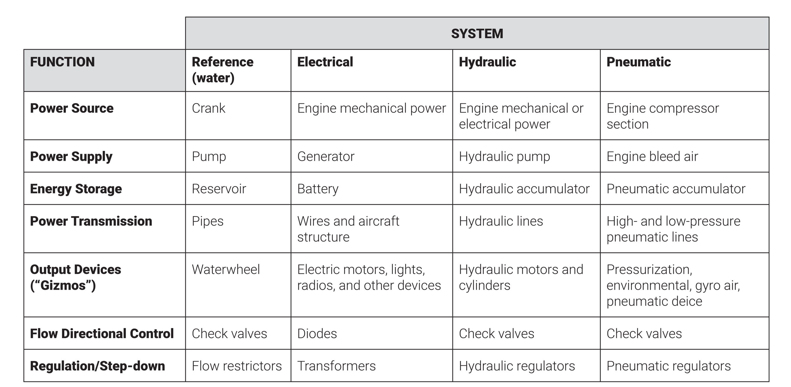
FIGURE 4.3
Comparison of aircraft power systems with reference waterwheel system.

Slide 6
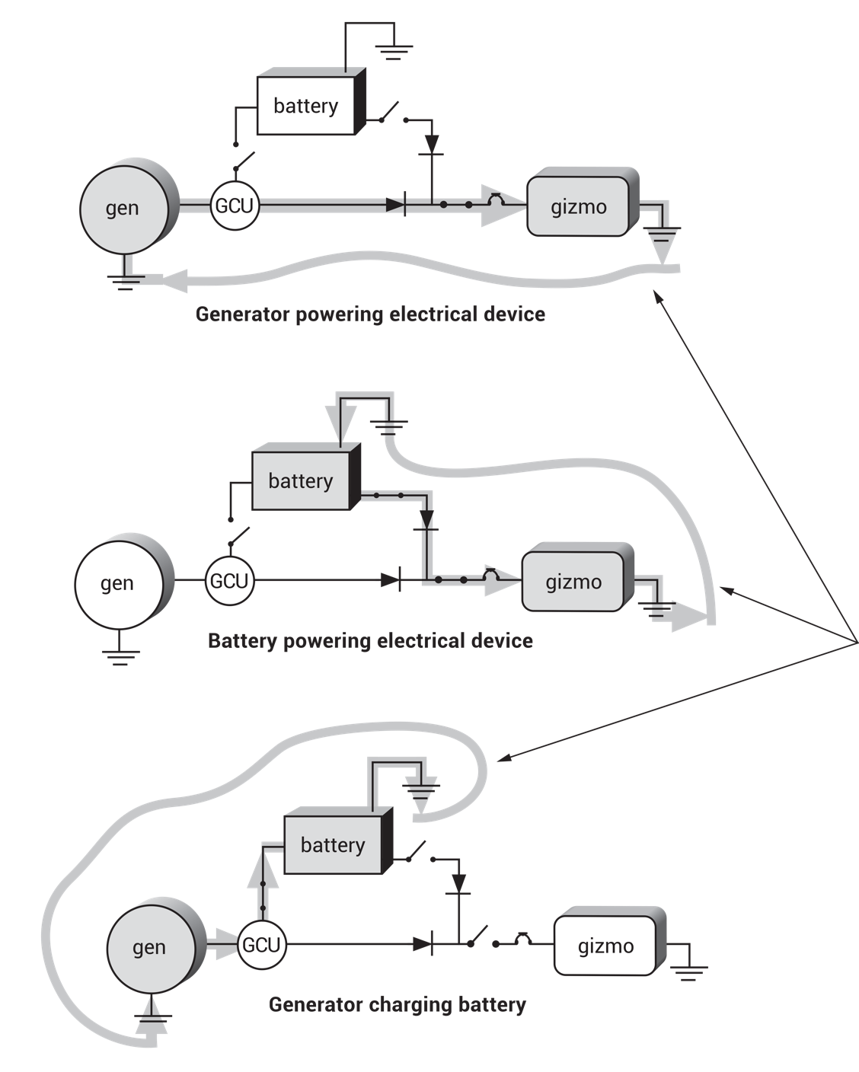
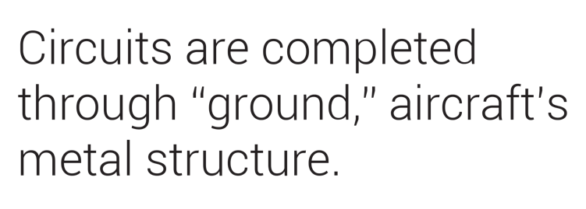
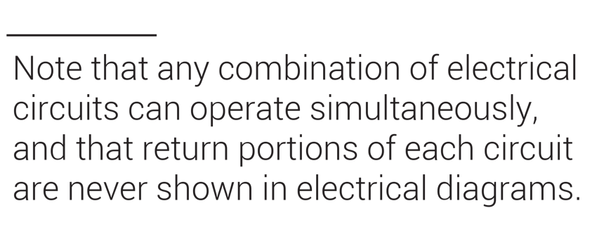
Generator powering electrical device
Battery powering electrical device
Generator charging battery
FIGURE 4.4
Basic electrical circuits.

Slide 7
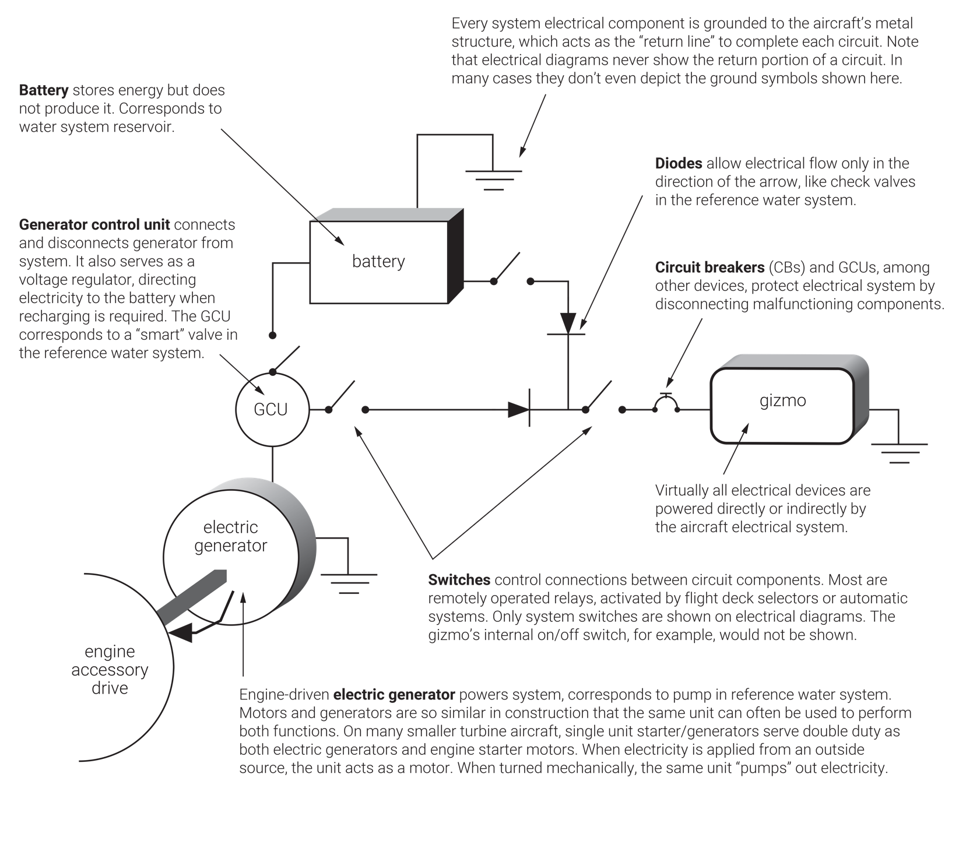
FIGURE 4.5
Basic electrical components.

Slide 8
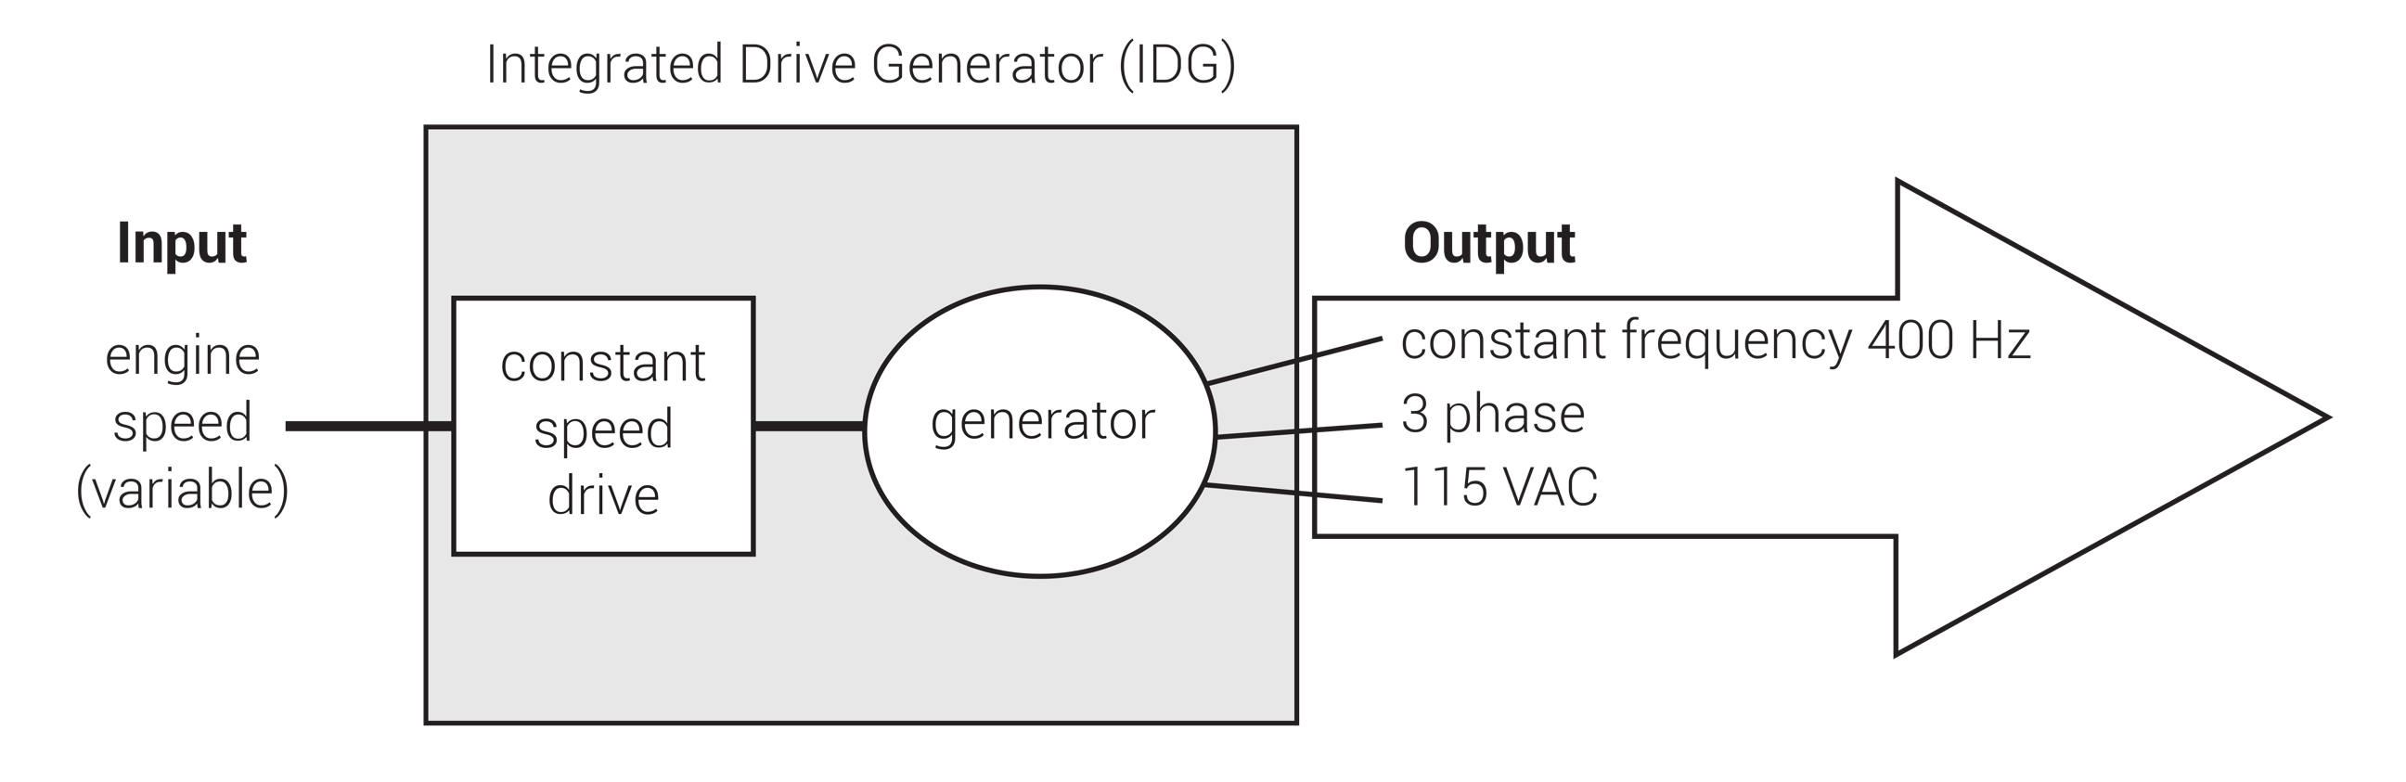
FIGURE 4.6
Integrated drive generator (IDG).

Slide 9
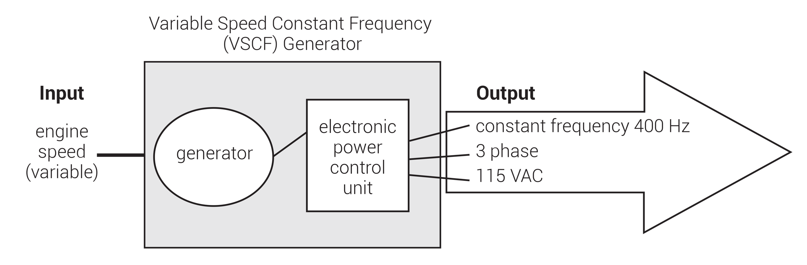
FIGURE 4.7
Variable speed constant frequency generator (VSCF).

Slide 10
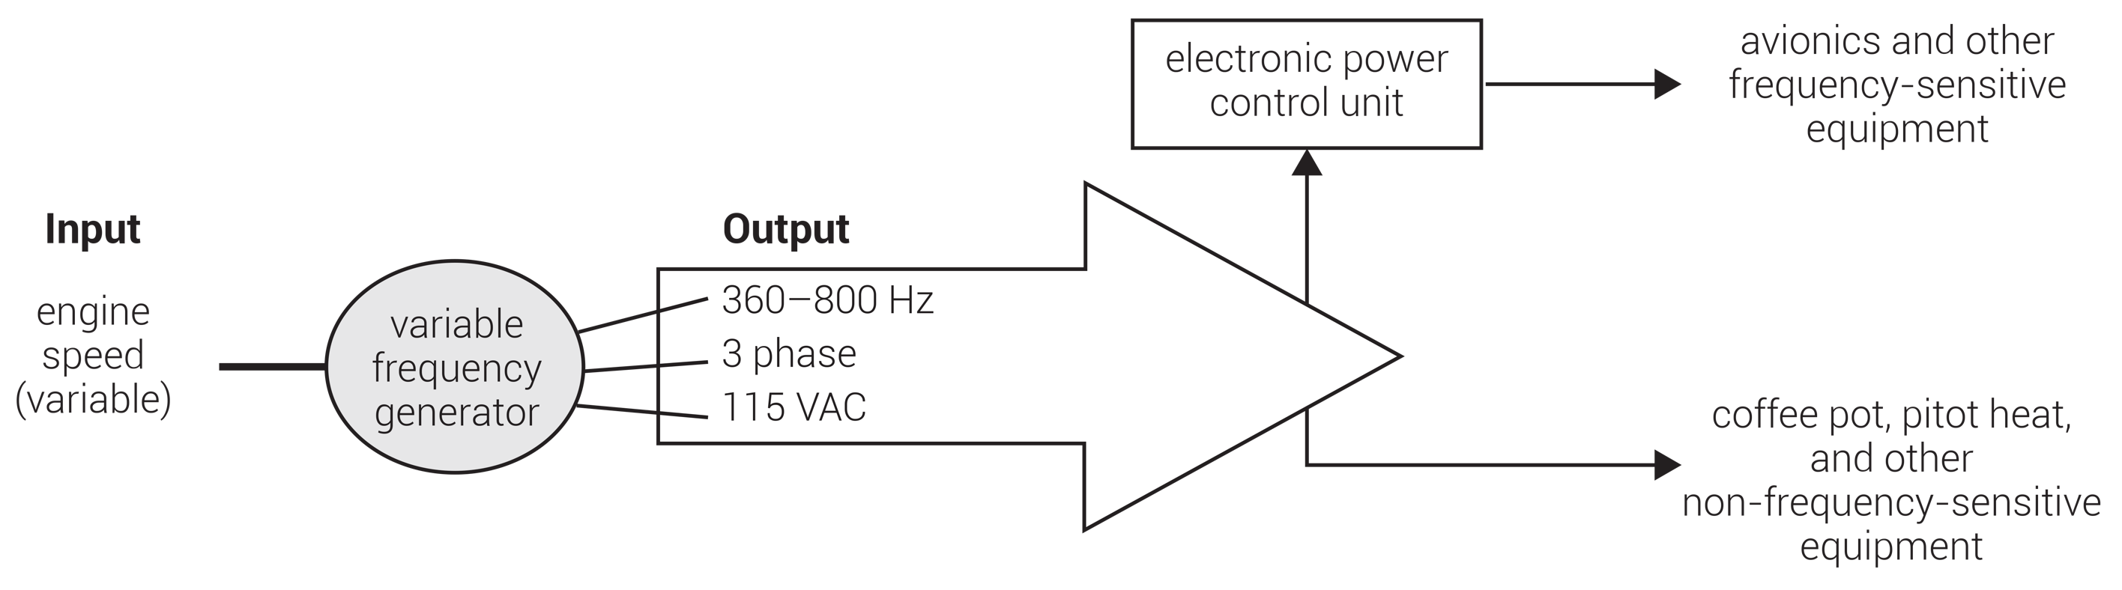
FIGURE 4.8
Variable frequency generator (VFG).

Slide 11
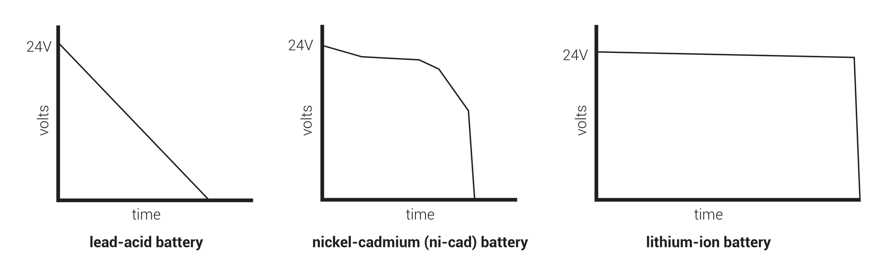
FIGURE 4.9
Comparison of lead-acid, ni-cad, and lithium-ion battery performance over time.

Slide 12
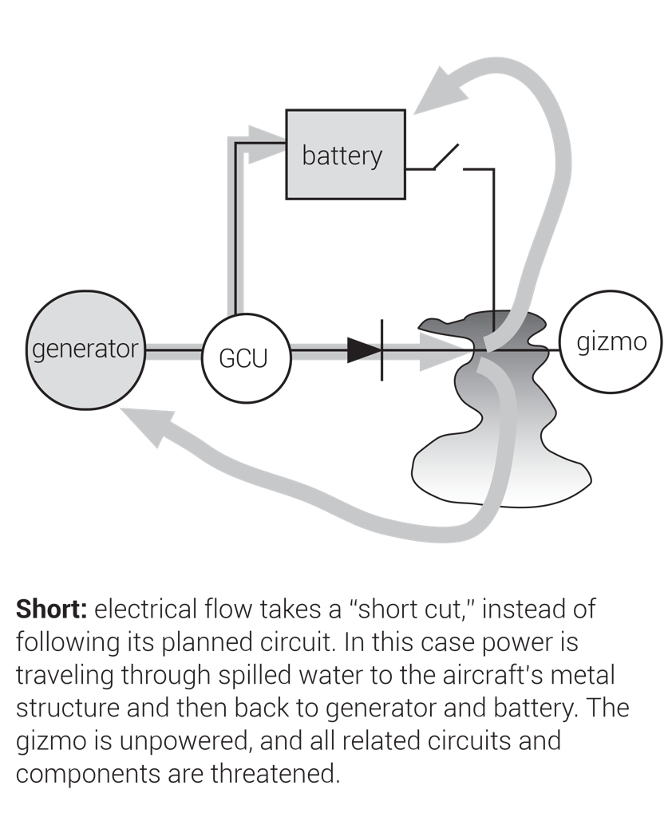
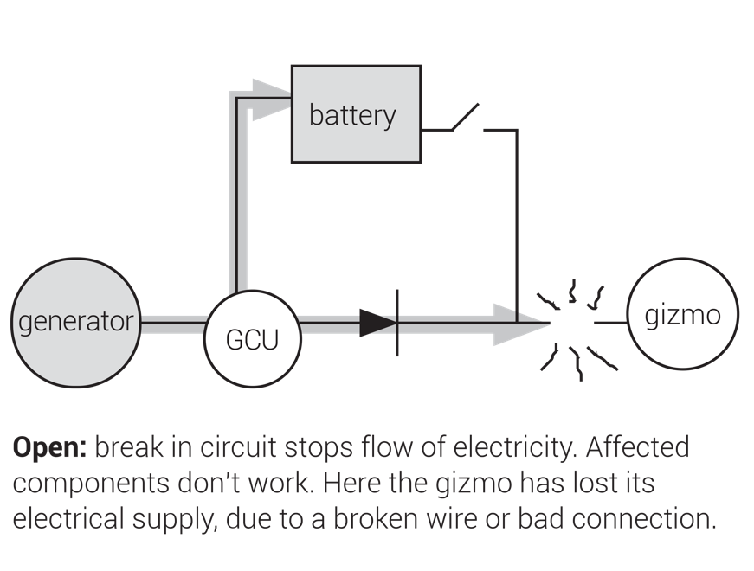
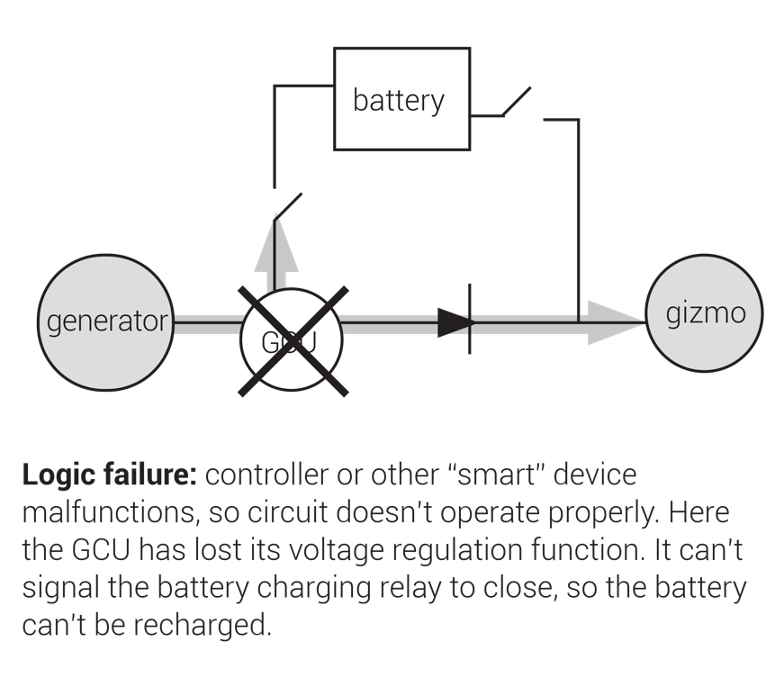
FIGURE 4.10
Electrical faults.

Slide 13
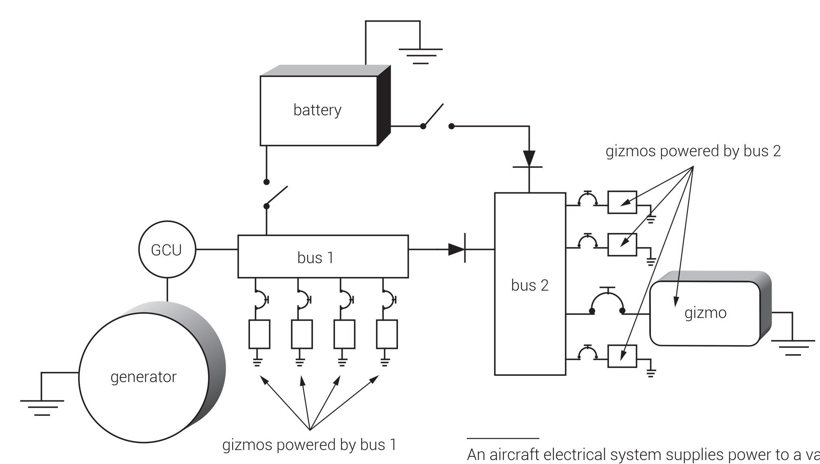
An aircraft electrical system supplies power to a variety of electrical buses, each of which acts as a manifold to supply various electrical components. Since each is separately powered, malfunctioning buses can be isolated from the rest of the electrical system, thereby protecting the system. Even if components on a failed bus are unusable, backup components powered by other buses can keep operating. Redundant systems are always powered by different electrical buses for this reason.
FIGURE 4.11
Electrical buses.

Slide 14
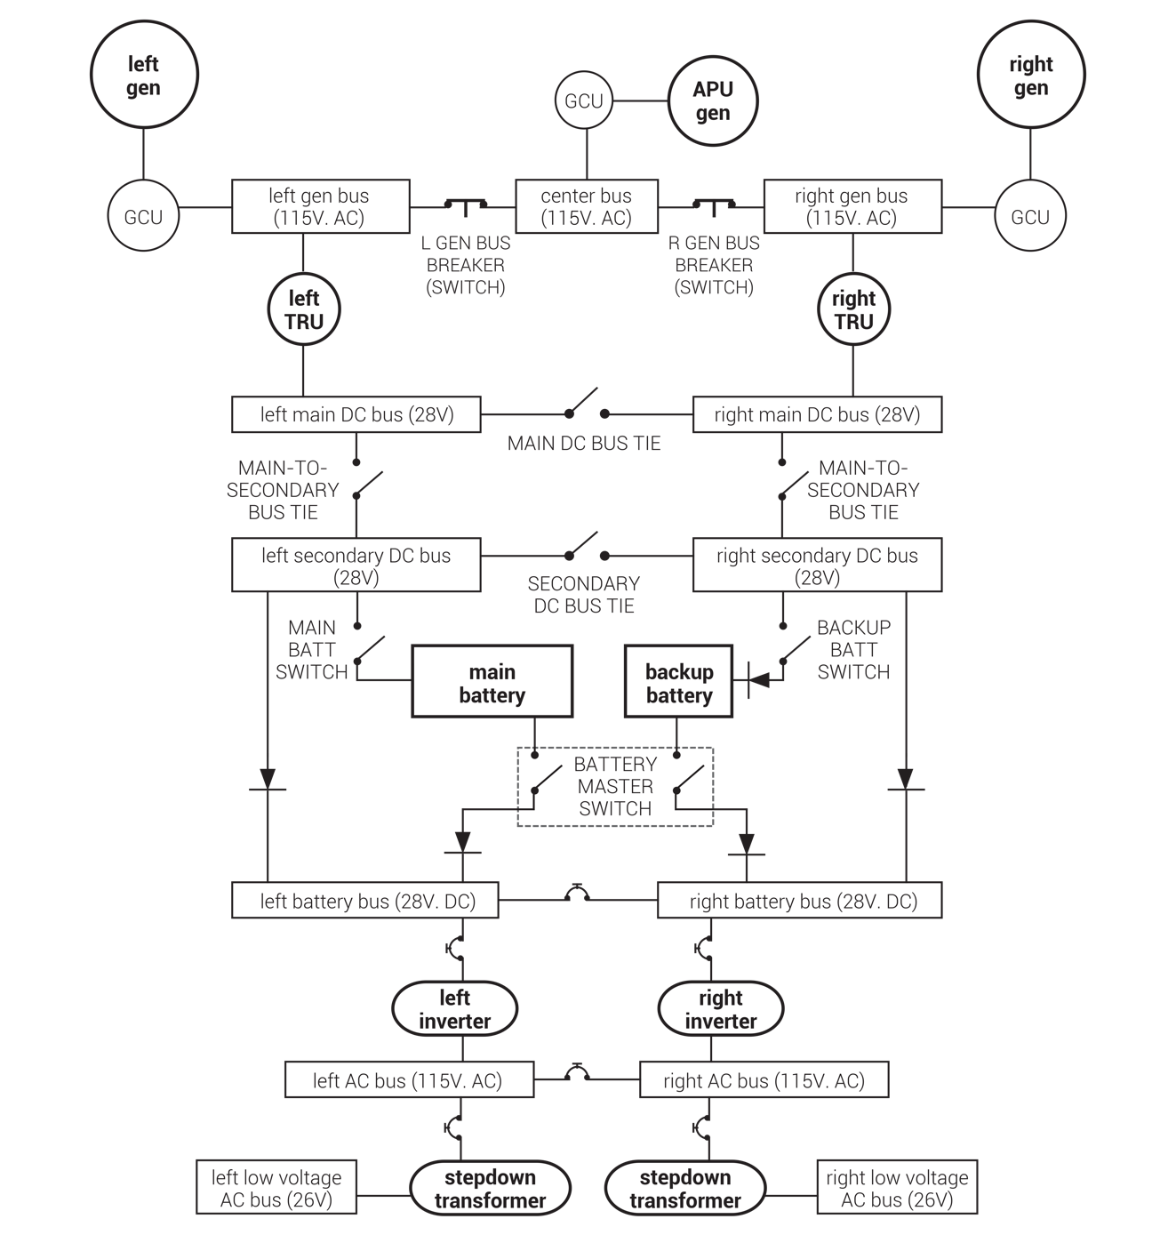
FIGURE 4.12
Aircraft electrical system diagram (shown unpowered).

Slide 15
Always start at the power source, and follow the flow of electricity through the system.
FIGURE 4.13
Reading an aircraft electrical system diagram.

Slide 16
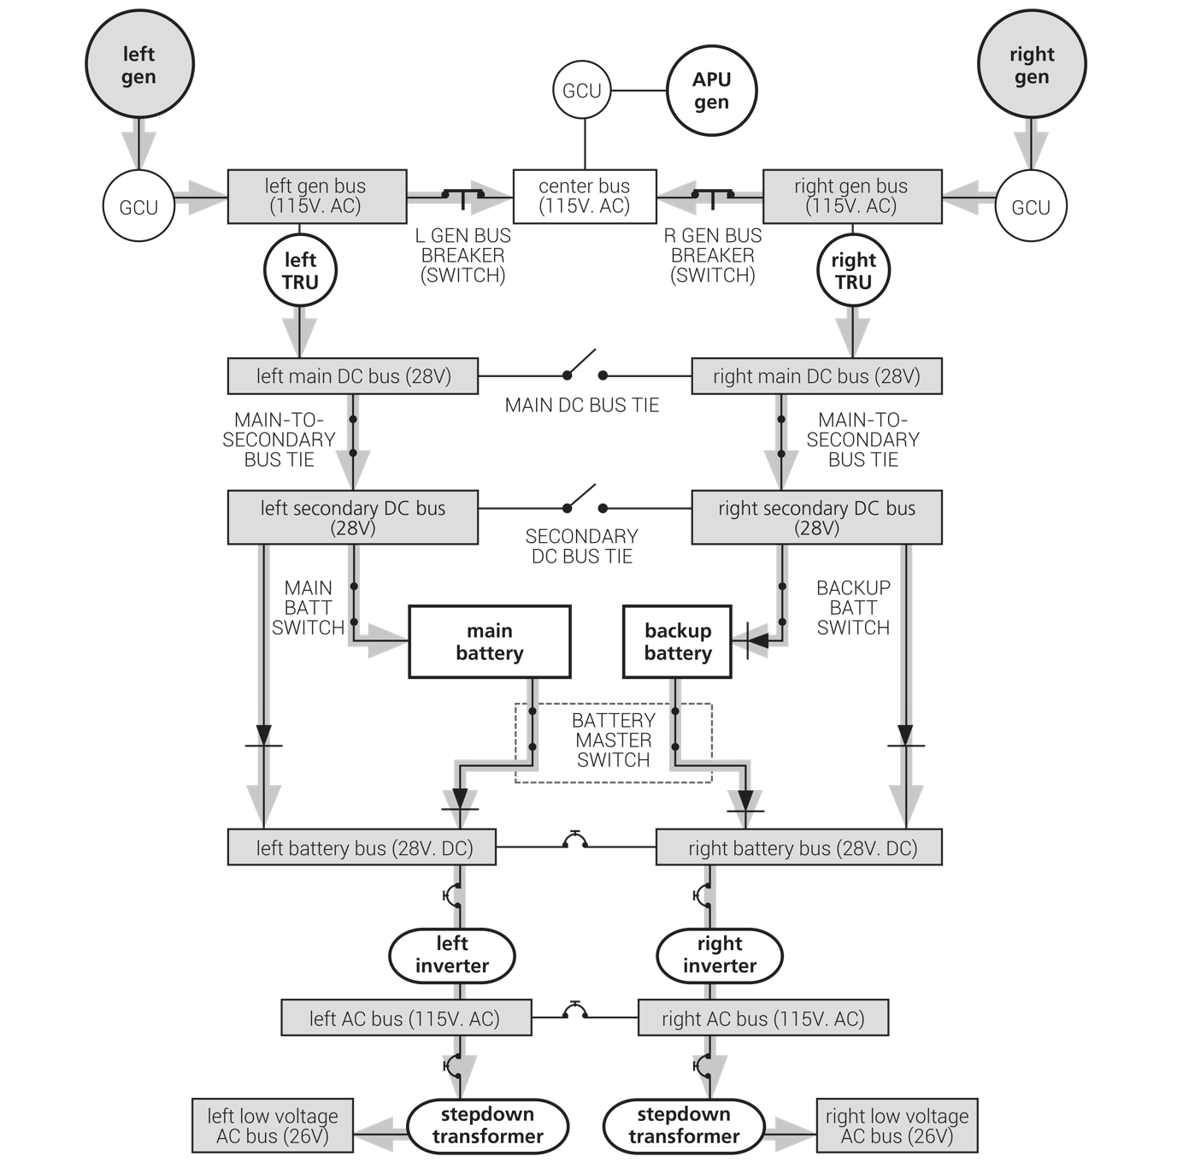
FIGURE 4.14
Aircraft electrical system: fully powered (APU off).

Slide 17
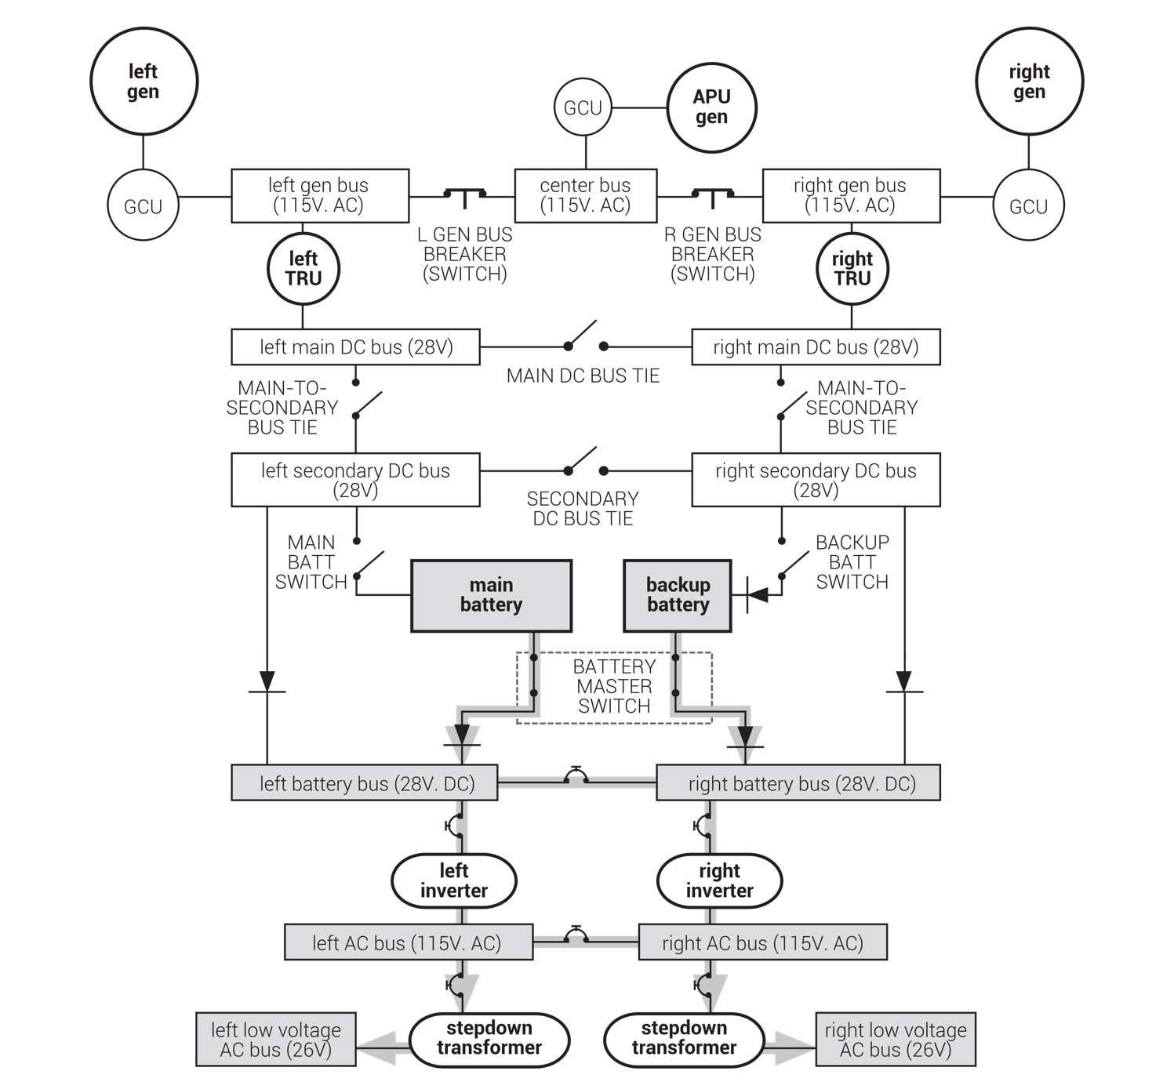
System is shown with battery master switch on, only. The batteries are powering the “battery buses,” “AC buses,” and “low voltage AC buses.” The rest of the DC buses can also be battery powered by closing the main battery switch and some bus ties. (But not for long; that’s lots of electrical load.) It is not possible to battery-power “center” or “gen buses” on this system.
FIGURE 4.15
Aircraft electrical system: battery power only.

Slide 18
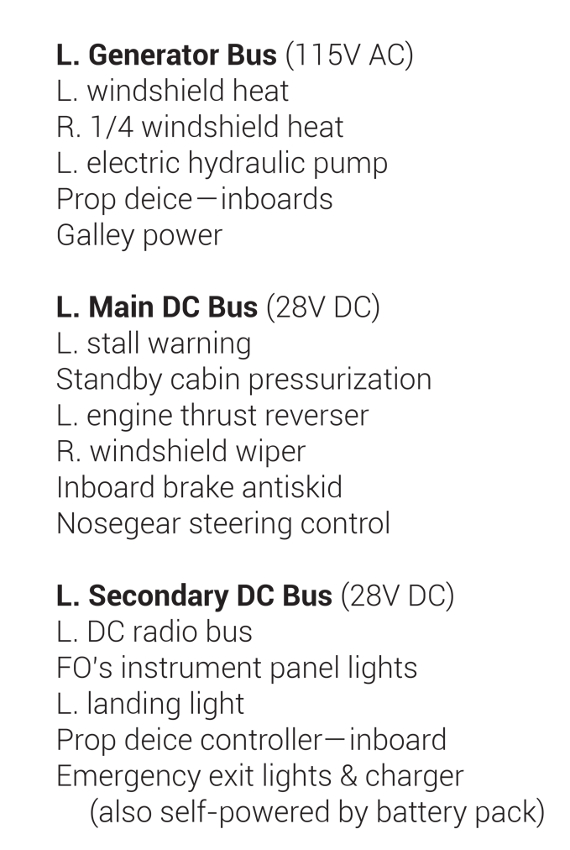
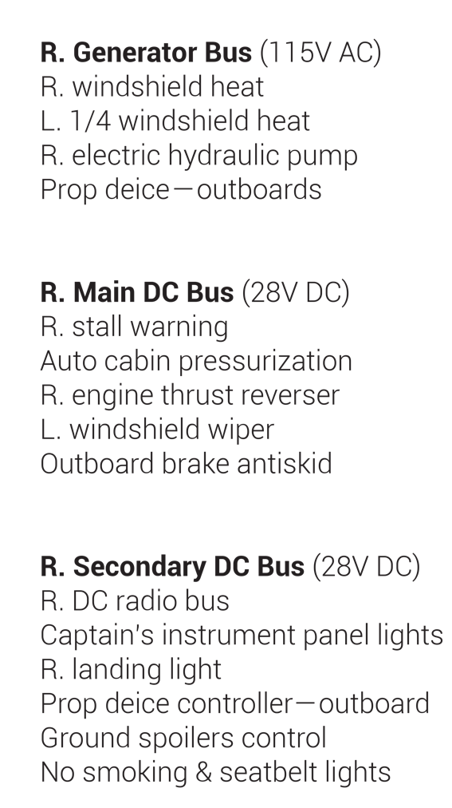
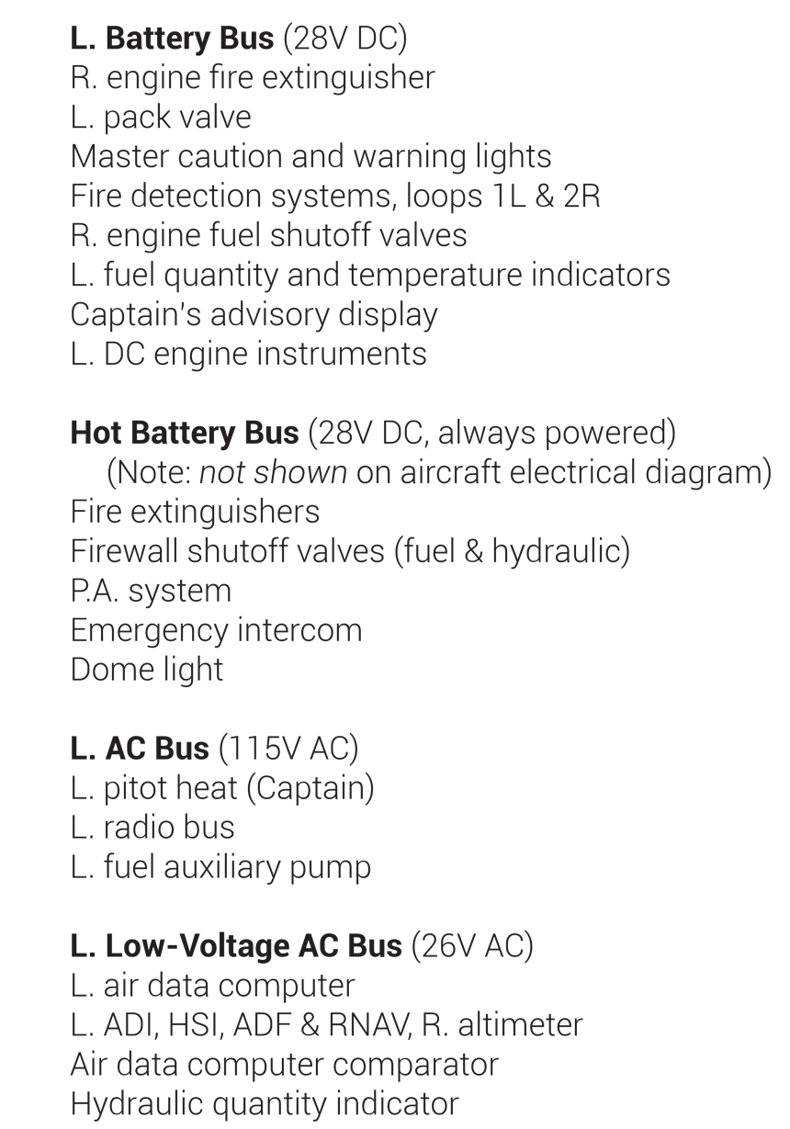
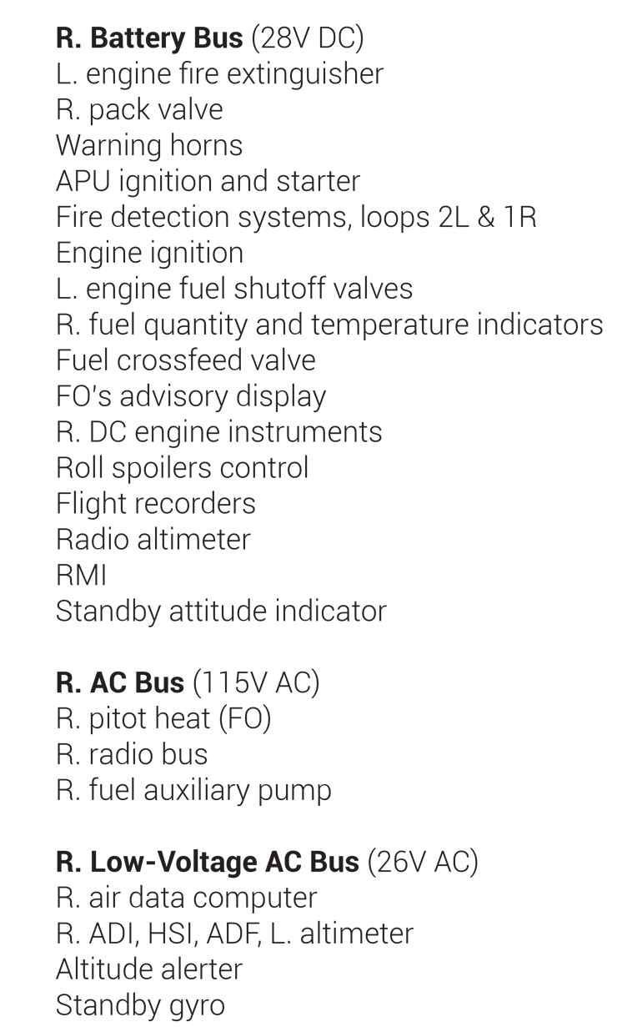
FIGURE 4.16
Distribution of electrical equipment by bus.

Slide 19
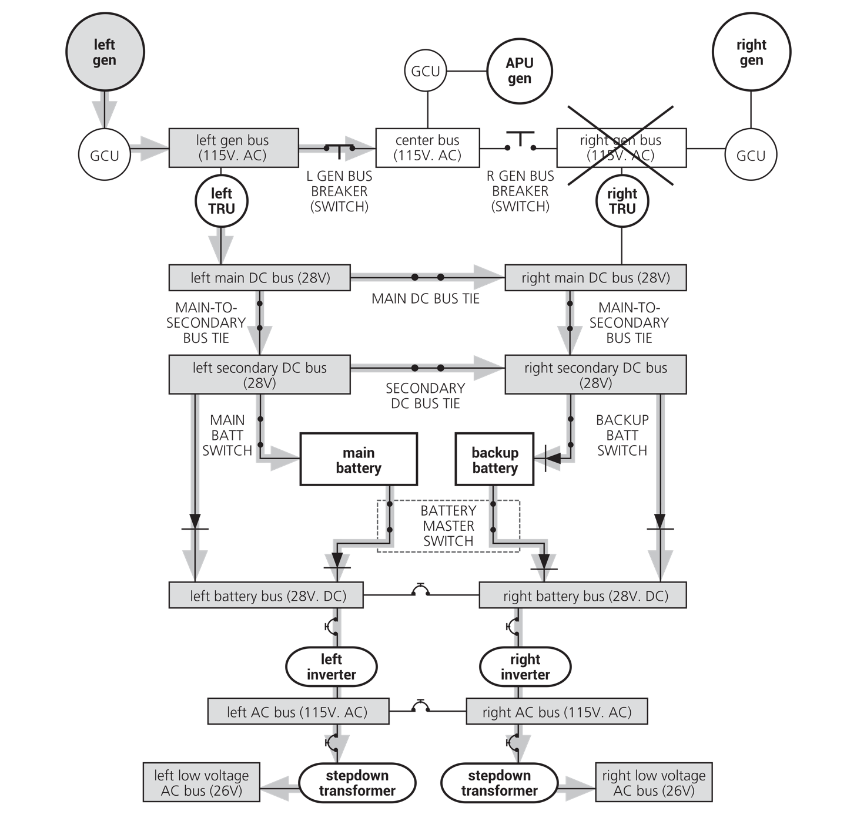
Right generator bus has been isolated due to fault. Pilots would be notified by caution or warning light, plus loss of various electrical components. Right GCU has taken right generator off line. Left generator is now powering all buses except for the “right gen bus.” Any components on that bus are unpowered, and plans must be made to complete the flight without them. Course of action begins with pilot call for “Generator Bus Failure Checklist.”
FIGURE 4.17
Aircraft electrical system: right generator bus fault.

Slide 20
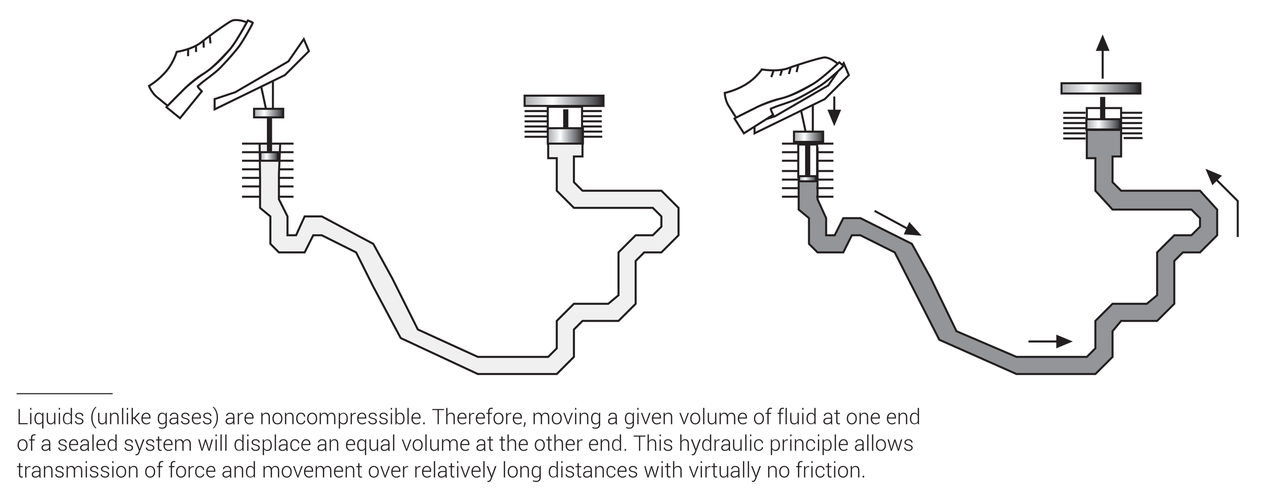
FIGURE 4.18
Hydraulic properties: power transmission.

Slide 21
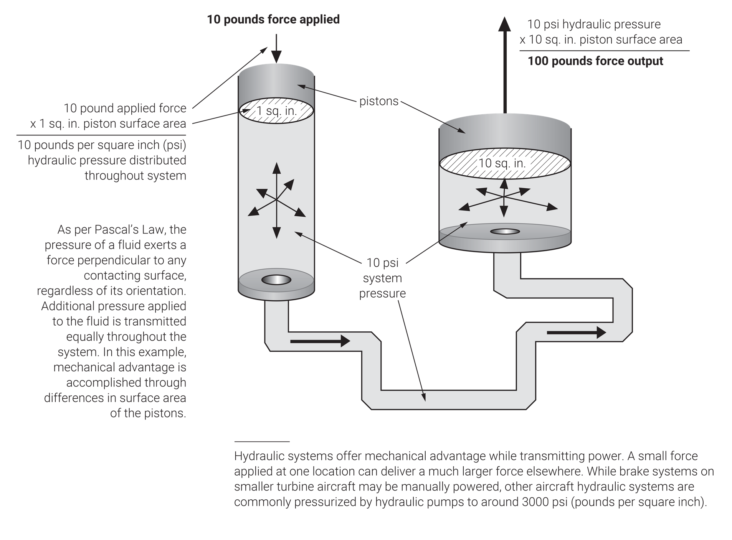
FIGURE 4.19
Hydraulic properties: mechanical advantage.

Slide 22
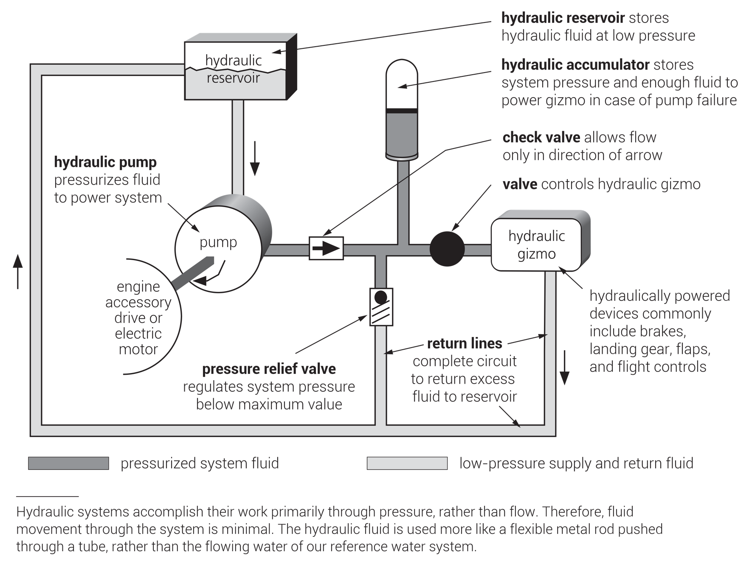
FIGURE 4.20
Basic hydraulic components.

Slide 23
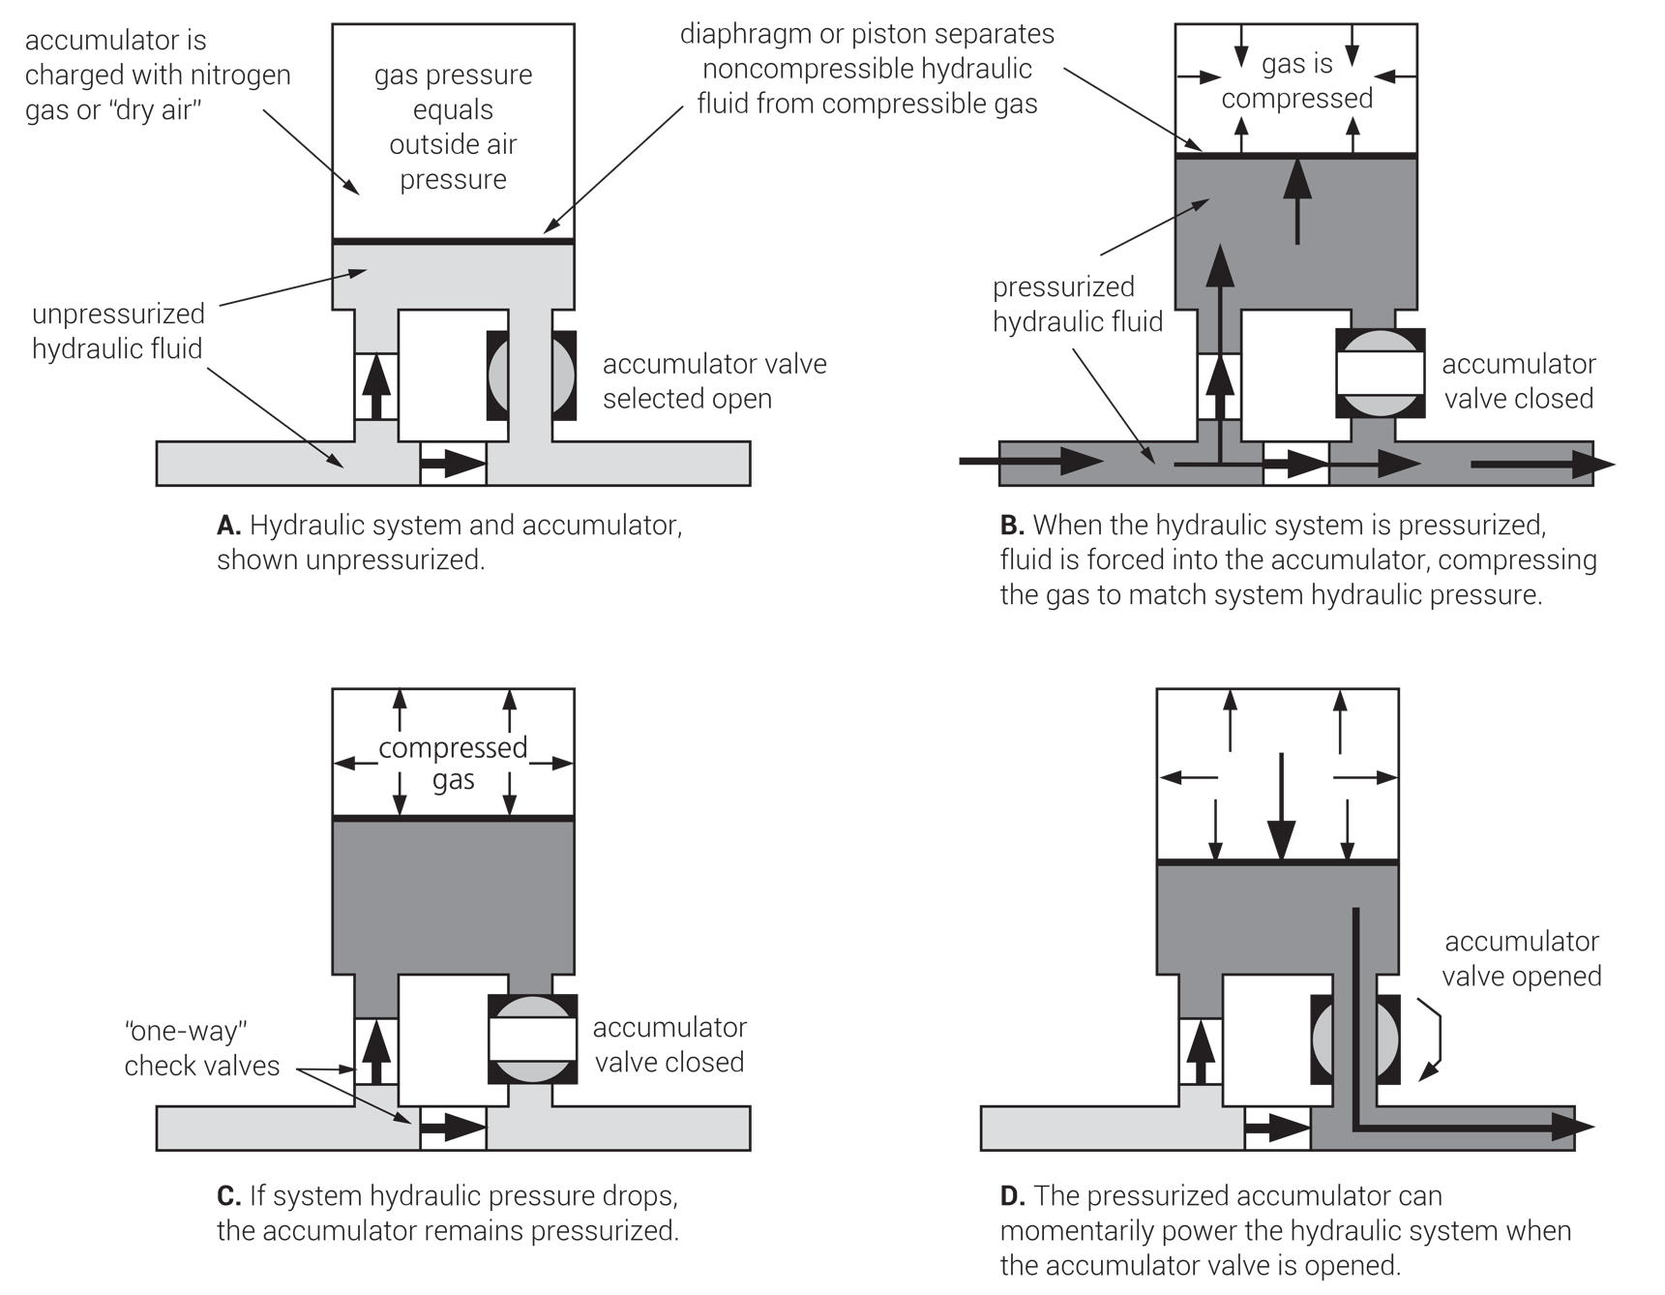
Hydraulic accumulators store system pressure as backup power sources for critical systems in the event of hydraulic pump failure. (They store only enough pressure for limited or one time use.) This type, with selectable accumulator valve, would likely power emergency flap or landing gear extension. Other types, such as brake accumulators, may simply provide backup pressure and have no selectable valves.
FIGURE 4.21
Hydraulic accumulator.

Slide 24
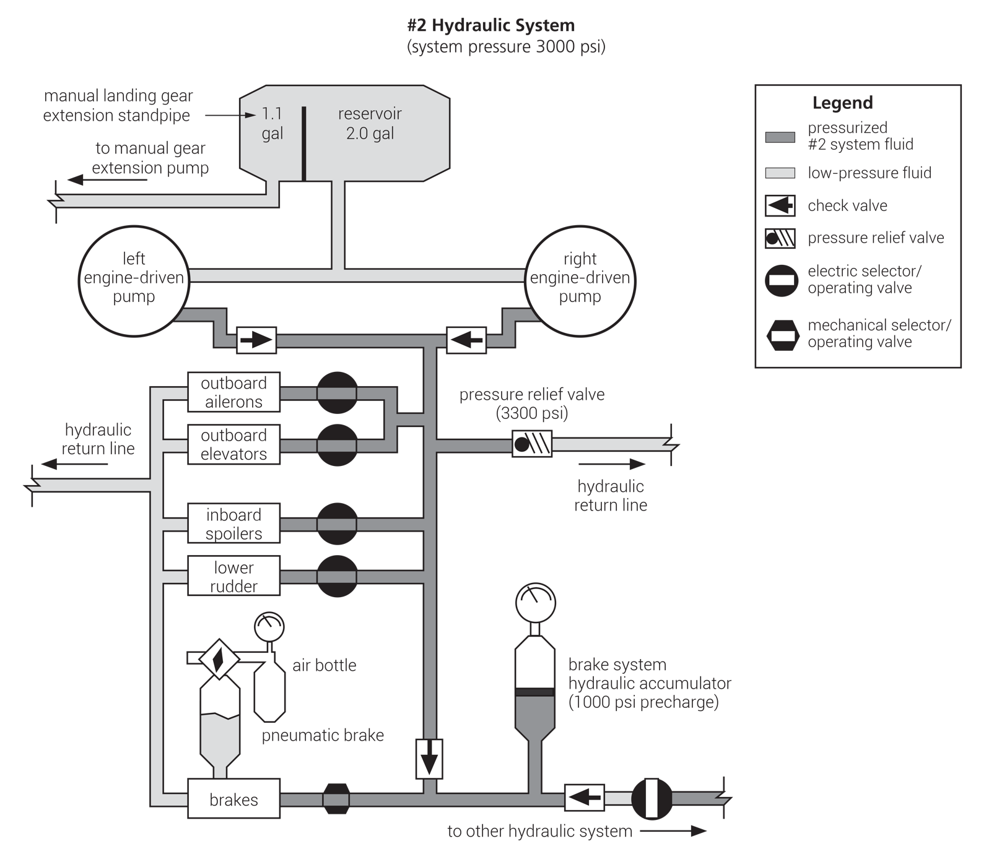
FIGURE 4.22
Aircraft hydraulic system diagram.

Slide 25
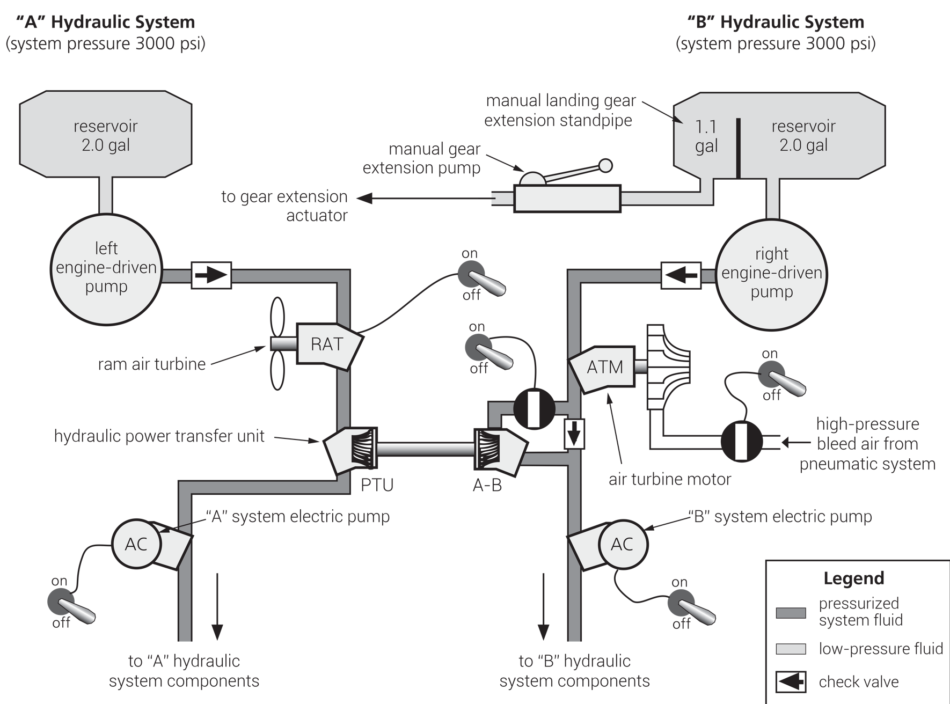
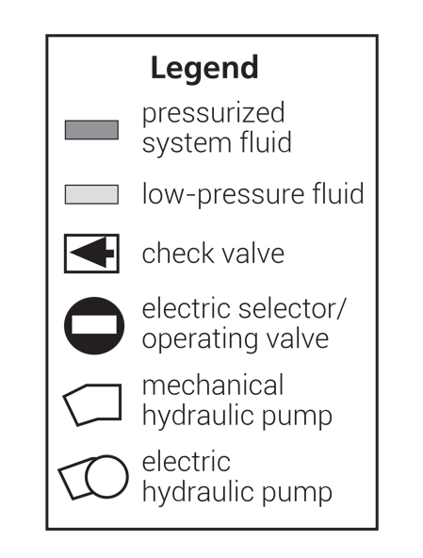
A variety of backup hydraulic pressure sources may be used to power critical hydraulic system functions should the primary engine-driven pumps fail. Depending upon the specific aircraft system, one or numerous backup pumps may be installed.
FIGURE 4.23
Backup hydraulic pumps.

Slide 26
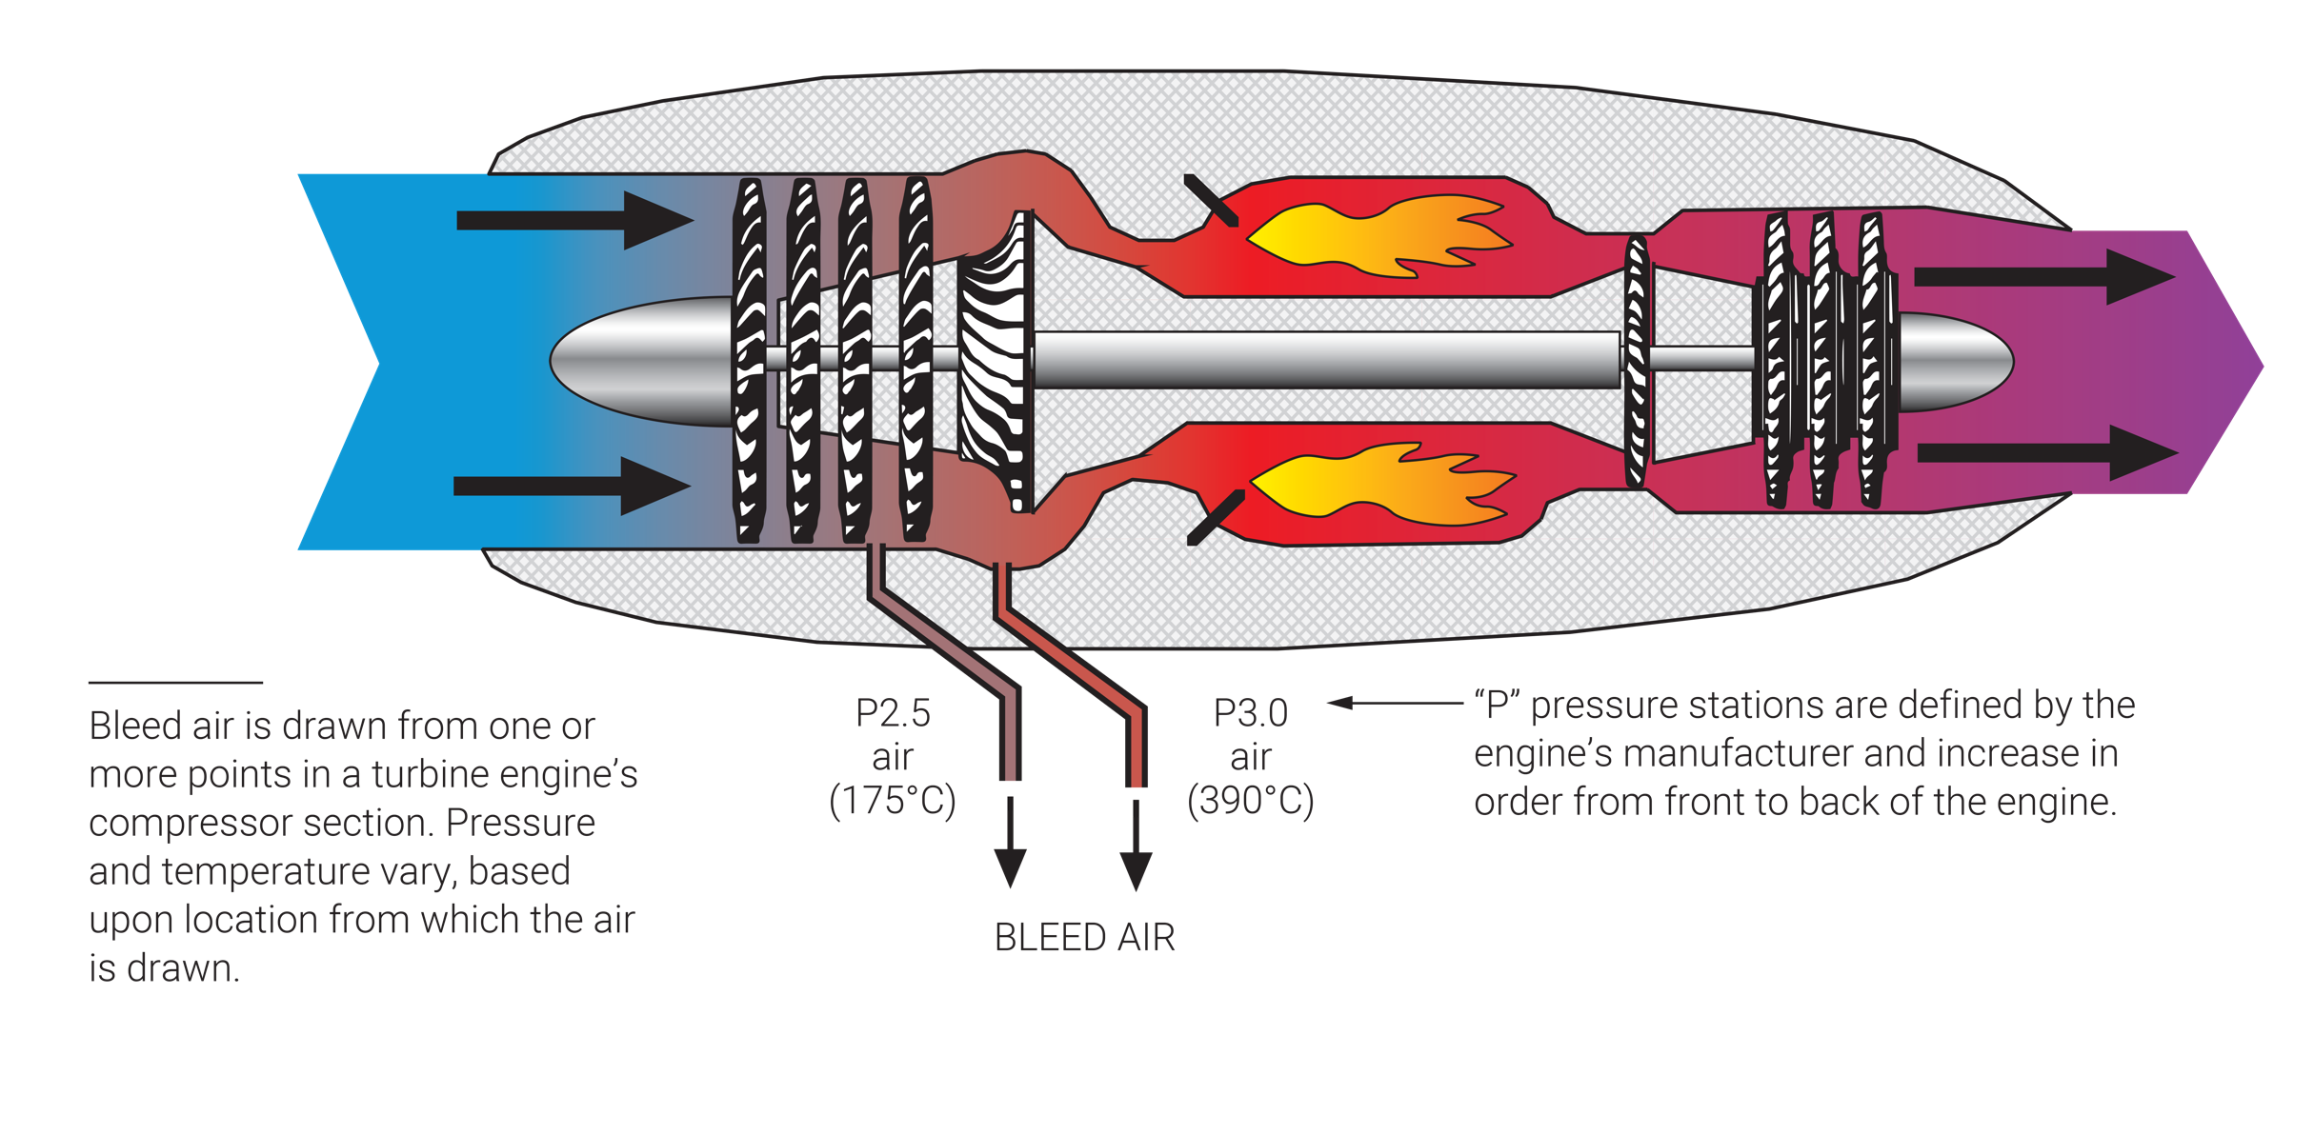
FIGURE 4.24
Bleed air.

Slide 27
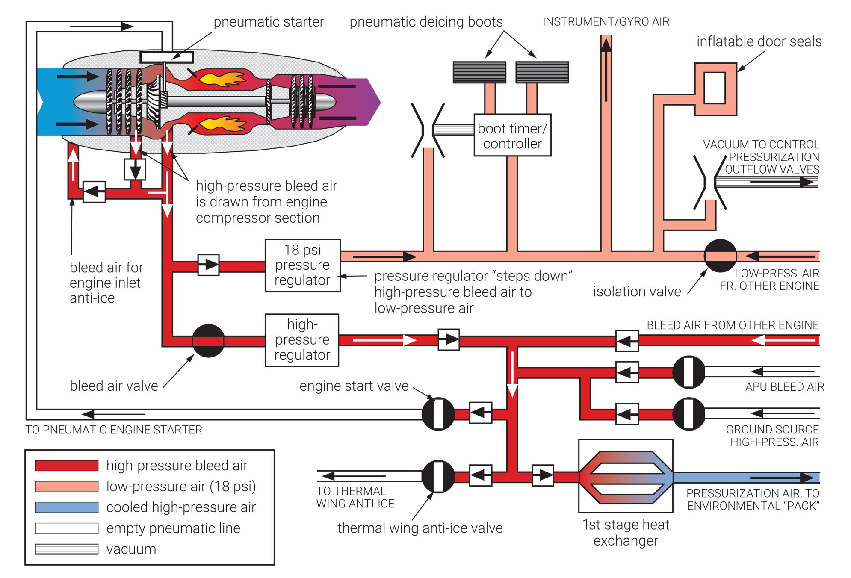
FIGURE 4.25
Pneumatic system components.

Slide 28
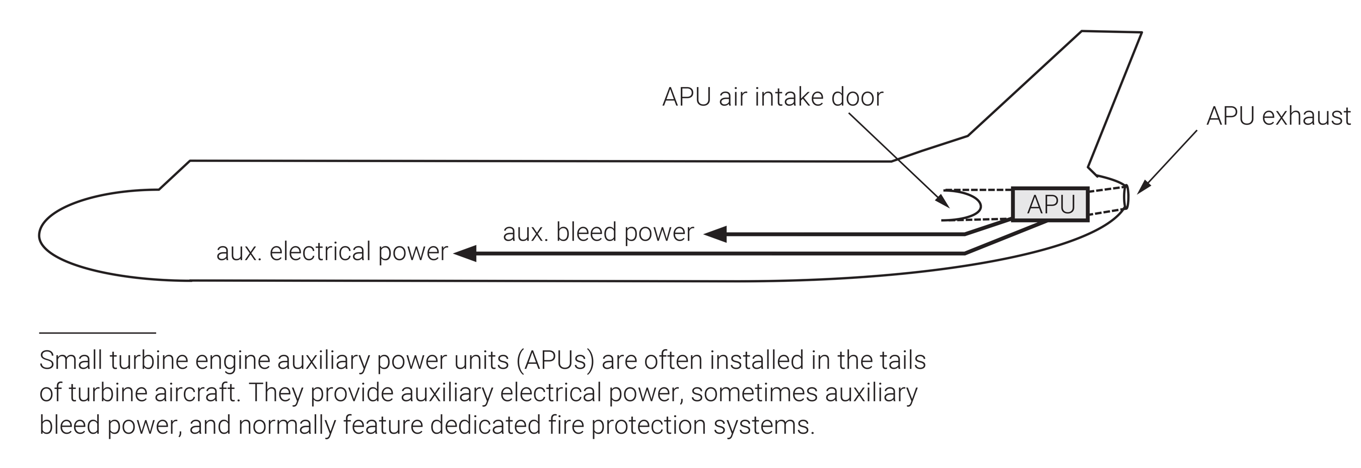
FIGURE 4.26
Common APU location.

Slide 29
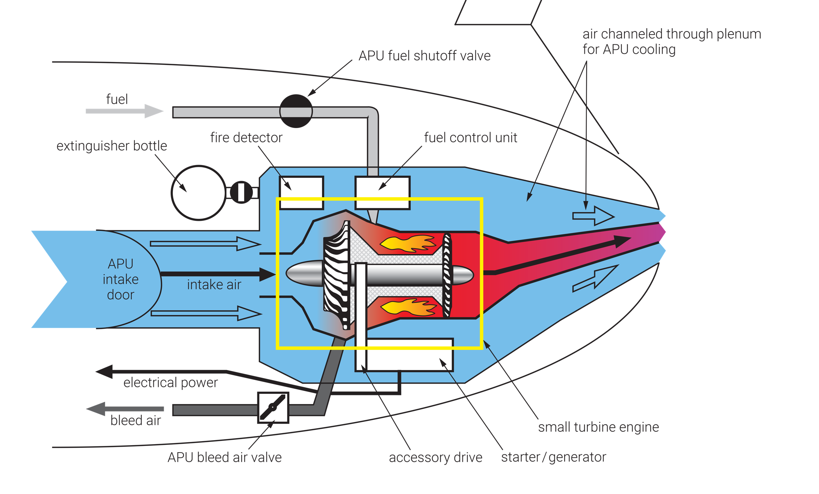
FIGURE 4.27
Typical APU (auxiliary power unit).

